Slide 1
Design Patterns III
Yuqun Zhang
CS304
Figures from Head First Design Patterns

Slide 2
The Singleton Pattern

Slide 3
The Notion of a Singleton
There are many objects we only need one of:
Thread pools, caches, dialog boxes, logging objects, device drivers, etc.
In many cases, instantiating more than one of such objects creates all kinds of problems (e.g., incorrect program behavior, resource overuse, inconsistent results)
We could just use global (static) variables
The Singleton pattern gives all of the upsides without the downsides
E.g., object isn’t forced to be created when the application starts
Basically, the Singleton is used anytime you want every object in the application to use the same global resource

Slide 4
Towards a Singleton
In Java, how do you create a single object?
new myObject();
And if you call that a second time?
You get a second, distinct object
Can you always instantiate a class this way?
How could you prevent such instantiation?
public class MyClass { private MyClass() {} }
Who can use such a private constructor?
Only code within MyClass

Slide 5
Towards a Singleton (cont.)
How can you get access to code within MyClass if you can’t instantiate it?
What does this do:
public class MyClass { public static MyClass getInstance() { … } }
How would you call that?
MyClass.getInstance();
How would you fill out the implementation to make sure that only a single instance of MyClass is ever created?

Slide 6
The Classic Singleton
We have a static variable to hold our one instance of the class Singleton
public class Singleton {
private static Singleton uniqueInstance;
// …
private Singleton() {}
public static Singleton getInstance() {
if (uniqueInstance == null) {
uniqueInstance = new Singleton();
}
return uniqueInstance;
}
// …
}
Our constructor is declared private; only Singleton can instantiate this class!
The getInstance() method gives us a way to instantiate the class and also to return an (the) instance of it.

Slide 7
The Singleton Pattern
The Singleton Pattern ensures a class has only one instance and provides a global point of access to that instance.

Slide 8
The Singleton Class Diagram

Slide 9
We have a problem…
The Singleton pattern, as we have implemented it, is not thread safe
Let’s explore what happens when multiple threads access the singleton pattern simultaneously.
Draw a sequence diagram with three actors
The Singleton object
Two “client” threads
Show a sequence of legal calls to the Singleton object’s getInstance() method (including its internals) that results in the instantiation of two objects

Slide 10
An example
1 public static ChocolateBoiler getInstance() {
2 if (uniqueInstance == null) {
3 uniqueInstance = new ChocolateBoiler();
}
4 return uniqueInstance;
}

Slide 11
The “Fix” is Easy
public class Singleton {
private static Singleton uniqueInstance;
// …
private Singleton() {}
public static synchronized Singleton getInstance() {
if (uniqueInstance == null) {
uniqueInstance = new Singleton();
}
return uniqueInstance;
}
// …
}
By adding the synchronized keyword, we force every thread to wait its turn before it can enter the method. That is, no two threads may be in the method at the same time
This turns out to not be a great idea. Why?
Synchronization is expensive. But that’s not all…
When is synchronization really necessary?

Slide 12
Whoops. What are the options, then?
Just roll with synchronized getInstance() anyway. Maybe the performance of getInstance() isn’t a big deal for you.
Use eager instantiation instead of lazy instantiation
public class Singleton { private static Singleton uniqueInstance = new Singleton(); private Singleton() {} public static Singleton getInstance() { return uniqueInstance; } }

Slide 13
One more option…
The volatile keyword ensures that multiple threads handle the uniqueInstance correctly when it is being initialized to the Singleton instance
Double checked locking (Java 5 and later)
public class Singleton { private volatile static Singleton uniqueInstance; private Singleton () {} public static Singleton getInstance() { if (uniqueInstance == null) { synchronized (Singleton.class) { if (uniqueInstance == null) { uniqueInstance = new Singleton(); } } } return uniqueInstance; } }
Check for an instance; if there isn’t one, enter the synchronized block
Once in the block, check again and if still null, create an instance
Notice that we only synchronize the first time through!
This approach can drastically reduce the overhead of synchronization

Slide 14
The Command Pattern

Slide 15
The Mission: A Remote Control

Slide 16
The Vendor Classes

Slide 17

Towards a Design
Yeah, the remote shouldn’t have a bunch of switch statements that select between devices…
We really need to decouple the requester of the action from the object that performs the action
We need some information hiding and separation of concerns
Yeah! What’s with all the different method names?
The remote is simple, but the devices are not!

Slide 18
Command Objects (in context)
We introduce command objects into the design
A command object encapsulates a request to do something (e.g., turn on a light) on a specific object (e.g., the living room lamp)
We can then just store a command object for each button such that when the button is pressed, the command is invoked
The button doesn’t have to know anything about the command

Slide 19
An Analogy
An order slip encapsulates a request to prepare a meal. It’s method orderUp() encapsulates the actions needed to prepare the meal; it also carries its own reference to the appropriate Cook
The waitress just creates order slips and invokes the orderUp() method.
The Cook knows how to prepare the meals; but he’s completely decoupled from the waitress (they need never directly communicate)

Slide 20
The Command Pattern in General

Slide 21
Quick Quiz
Match the diner objects to the Command Pattern
Waitress
Cook
orderUp()
Order
Customer
takeOrder()
Command
execute()
Client
Invoker
Receiver
setCommand()

Slide 22
Quick Quiz
Match the diner objects to the Command Pattern
Waitress
Cook
orderUp()
Order
Customer
takeOrder()
Command
execute()
Client
Invoker
Receiver
setCommand()

Slide 23
A First Command Object
Simple. Just one method called execute()
public interface Command {
public void execute ();
}
public class LightOnCommand implements Command {
Light light;
public LightOnCommand (Light light) {
this.light = light;
}
public void execute () {
light.on();
}
}
The constructor is passed the specific light that this command controls. When execute() gets called, this is the light that will be the receiver of the request

Slide 24
Using the Command Object
public class SimpleRemoteControl {
Command slot;
public SimpleRemoteControl () { }
public void setCommand(Command command) {
slot = command;
}
public void buttonWasPressed() {
slot.execute();
}
}
We have one slot to hold a command, which will control one device
We have a method to set the command the slot will control; could be called multiple times to change the behavior of the button
This method is called when the button is pressed. All we do is take the current command bound to the slot and call its execute() method

Slide 25
A Simple Test of the Remote
The RemoteControlTest class is the Client
public class RemoteControlTest {
public static void main(String[] args) {
SimpleRemoteControl remote =
new SimpleRemoteControl();
Light light = new Light();
LightOnCommand lightOn = new LightOnCommand(light);
remote.setCommand(lightOn);
remote.buttonWasPressed();
}
}
The remote is the Invoker; it will be passed a command object that can be used to make requests
The Light object is the Receiver of the request
We create a command and pass it the Receiver
Then we pass the command to the Invoker.

Slide 26
Can you do it?
Implement the FaucetOffCommand class
Here’s the new “test” code:
public class RemoteControlTest {
public static void main(String[] args) {
SimpleRemoteControl remote = new SimpleRemoteControl();
Faucet faucet = new FaucetControl();
FaucetOffCommand faucetOff = new FaucetOffCommand(faucet);
remote.setCommand(faucetOff);
remote.buttonWasPressed();
}
}

Slide 27
Solution
public class FaucetOffCommand implements Command {
Faucet faucet;
public FaucetOffCommand(Faucet faucet) {
this.faucet = faucet;
}
public void execute () {
faucet.closeValve();
}
}

Slide 28
The Command Pattern
The Command Pattern encapsulates a request as an object, thereby letting you parameterize other objects with different requests, queue or log requests, and support undoable operations.

Slide 29
The Command Pattern

Slide 30
The Command Pattern in Action

Slide 31
The Command Pattern Class Diagram

Slide 32
Back to our Remote…

Slide 33
Question
How does the remote know the difference between the kitchen light and the living room light?
It doesn’t have to! The Receiver is encapsulated in the command that is inserted in the “slot.”

Slide 34
Implement Remote Control
public class RemoteControl{
Command[] onCommands;
Command[] offCommands;
public RemoteControl(){
onCommands = new Command[7];
...;
}
public void setCommand(int slot, Command onCommand, Command offCommand){
onCommands[slot] = onCommand;
...;
}
public void onButtonWasPushed (int slot){
onCommands[slot].execute();
}
...;
}

Slide 35
Let’s Add Support for the Undo Button
First, let’s expand the Command interface:
public interface Command { public void execute ();
public void undo ();
}
Now, every Command should be undoable
So we add an implementation for undo() for every command that we implement
E.g., for LightOnCommand, undo() simply calls light.off()
Some undo() method implementations are more complicated; e.g., undoing a change in speed of a ceiling fan
All that’s left is to add support to the remote control to handle tracking which undo() method to call
Store the last command executed; if the undo button is pressed, we can just invoke the undo() method on that command

Slide 36
The Adapter Pattern

Slide 37
The Adapter Analogy

Slide 38
The OO Adapter

Slide 39
Writing an Adaptor
Back to Ducks… but with interfaces this time:
public interface Duck {
public void quack();
public void fly();
}
public class MallardDuck implements Duck {
public void quack() {
System.out.println(“Quack”);
}
public void fly() {
System.out.println(“I’m flying!”);
}
}

Slide 40
A New Fowl…
public interface Turkey {
public void gobble();
public void fly();
}
public class WildTurkey implements Turkey {
public void gobble() {
System.out.println(“Gobble gobble”);
}
public void fly() {
System.out.println(“I’m flying a short distance!”);
}
}

Slide 41
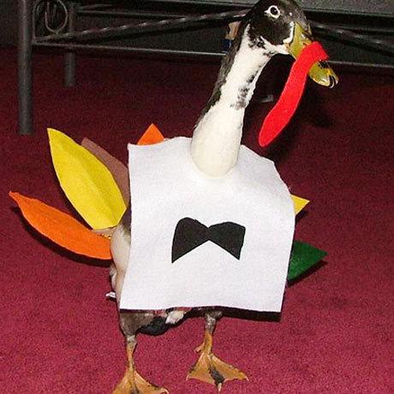
Now here’s my problem
I need turkeys. But all I have are ducks. Is there anyway to turn a duck into a turkey?

Slide 42
The TurkeyAdapter
First, implement the interface of the type that you’re adapting to. This is the interface your client expects.
public class TurkeyAdapter implements Duck {
Turkey turkey;
public TurkeyAdapter(Turkey turkey) {
this.turkey = turkey;
}
public void quack() {
turkey.gobble();
}
public void fly() {
for(int i = 0; i < 5; i++) {
turkey.fly();
}
}
}
We need to get a reference to the object that we’re adapting; here we just do that through the constructor.
We have to implement all of the methods in the interface
Even though both interfaces have the fly() method, the turkey’s fly is different than the duck’s. So we have to implement that logic.

Slide 43
Let's test it
public class DuckTestDrive{
public static void main(String[] args){
WildTurkey turkey = new WildTurkey();
Duck turkeyAdapter = new TurkeyAdapter(turkey);
testDuck(turkeyAdapter);
}
static void testDuck(Duck duck){
duck.quack();
duck.fly();
}
}

Slide 44
The Adapter Pieces

Slide 45
Questions
How much adapting can be done in an adapter?
That really depends on the particular situation and the particular interfaces. It could be just basic translation or massive amounts of work
Does an adapter always wrap only one class?
The real world can be messier; an adapter could wrap two or more adaptees needed to implement the target interface
However, the Adapter always converts one interface to another (the point is just that the definition of “interface” may not be limited to a single class)

Slide 46
The Adapter Pattern
The Adapter Pattern converts the interface of a class into another interface the client expects. Adapter lets classes work together that couldn’t otherwise because of incompatible interfaces.

Slide 47
The Adapter Class Diagram

Slide 48
Adapter Pattern and Good OO Design
Favor composition
The adaptee is wrapped with an altered interface using composition
Programming to an interface not an implementation
The client is only aware of the target interface

Slide 49
An Example Adapter in the Wild
Old World Enumerators…
Early Java collections types implemented an elements() method that returned an Enumeration of the elements that you could then step through without knowing how the collection was implemented
New World Iterators…
The Collections classes use an Iterator interface that implements a similar capability but also allows item removal
Never the twain shall meet
Oh, wait…

Slide 50
Backwards Compatibility
You know what that means, right?
We often have to work with legacy code that does it the old way.
But our clients insist (and they should) on using the new way.

Slide 51
Let’s Examine the Interfaces

Slide 52
The Class Diagram

Slide 53
How to Handle the remove() method
Enumeration simply doesn’t support remove; it’s “read only”
We can, however, throw a runtime exception if someone tries to call remove() on an EnumerationIterator
The Iterator class supports this; it’s remove method supports throwing an UnsupportedOperationException
In the end, the adapter isn’t perfect; clients will still have to deal with potential exceptions

Slide 54
The EnumerationIterator Adapter
Our adapter has to implement the Iterator interface
public class EnumerationIterator implements Iterator {
Enumeration enum;
public EnumerationIterator(Enumeration enum) {
this.enum = enum;
}
public boolean hasNext() {
return enum.hasMoreElements();
}
public Object next() {
return enum.nextElement();
}
public void remove() {
throw new UnsupportedOperationException();
}
}
Use composition to stash the enum
The Iterator’s hasNext() method is a direct map to the Enumeration’s hasMoreElements() method
The Iterator’s next() method is a direct map to the Enumeration’s nextElement() method
Throw the UnsupportedOerationException if someone tries to call remove

Slide 55
The FaCade Pattern
A special kind of adapter…

Slide 56
A Home Theater

Slide 57

Watching a Movie
Sit back, relax, and…
Turn on the popcorn popper
Start the popper popping
Dim the lights
Put the screen down
Turn the projector on
Set the projector input to DVD
Put the projector in wide-screen mode
Turn the sound amplifier on
Set the amplifier to DVD input
Set the amplifier to surround sound
Set the amplifier volume to medium (5)
Turn the DVD player on
Start the DVD player playing

Slide 58
Codes
Popper.on();
Popper.pop();
Lights.dim(10);
Screen.down();
Projector.on();
Projector.setInput(dvd);
Projector.widScreenMode();
Amp.on();
Amp.setDvd(dvd);
Amp.setSurroundSound();
Amp.setVolume(5);
Dvd.on();
Dvd.play(movie);

Slide 59
Further Complications…
When the movie finishes, you have to do it all in reverse!
Doing a slightly different task (e.g., listen to streaming audio) is equally complex
When you upgrade your system, you have to learn a slightly different procedure

Slide 60
watchMovie()

Slide 61
Sidebar: Façade vs. Adapter
A façade not only simplifies an interface, but it also decouples a client from a subsystem of components
Facades and adapters may wrap multiple classes
A façade’s intent is to simplify
An adapter’s intent is to convert the interface into something different
A façade does not encapsulate; it just provides a simplified interface

Slide 62
The Home Theater Façade

Slide 63
The Home Theater Façade

Slide 64
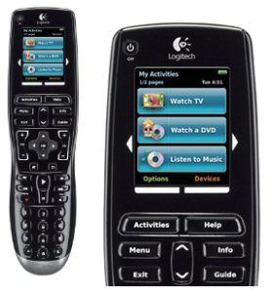
One Remote to Rule them All

Slide 65
The Façade Pattern
The Façade Pattern provides a unified interface to a set of interfaces in a subsystem. Façade defines a higher-level interface that makes the subsystem easier to use.

Slide 66
A Sidebar: The Principle of Least Knowledge
As a general design principle, you should reduce the interactions between objects to just a few “close friends”
Be careful of the number of classes an object interacts with and also how it comes to interact with those classes
Prevents creating designs that have a very high degree of coupling among classes (these systems are much more fragile)
General guidelines:
Only invoke methods that belong to
The object itself
Objects passed as parameters to the method
Any object the method creates or instantiates
Any components of the object
Do not invoke methods on objects that were returned from calling other methods!

Slide 67
An Example

Slide 68
Principle of Least Knowledge
a.k.a. Law of Demeter
Advantages
Reduces dependencies between objects, which has been demonstrated to reduce maintenance costs
Disadvantages
Results in more “wrapper” classes to avoid method calls to other components
This can result in increased complexity and development time

Slide 69
Examples of Good Practice

Slide 70
Exercise
Does this violate the Principle of Least Knowledge?

Slide 71
Exercise
Does this violate the Principle of Least Knowledge?

Slide 72
Façade and the Principle of Least Knowledge

Slide 73
Bridge Pattern

Slide 74
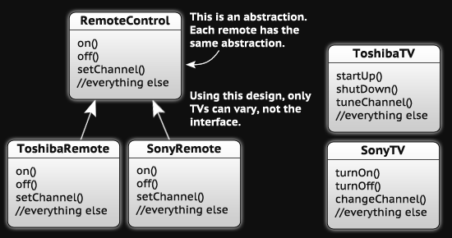
The Scenario
You’re writing code for a new remote control for TVs
You’re a good OO designer, so you’ll make good use of abstraction
You’ll have a RemoteControl base class and multiple implementations, one for each model of TV

Slide 75
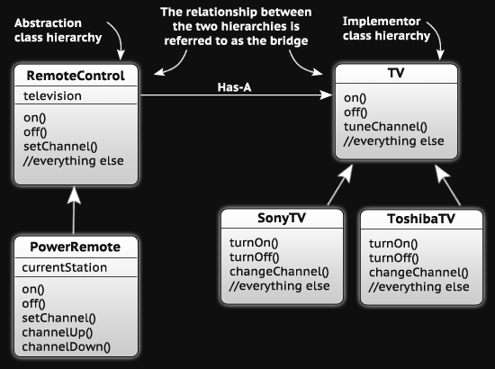
The Dilemma
The problem is that only the implementations can vary
You need to make it possible for the abstraction to vary
Do you remember “favor composition over inheritance”?
How can we employ that?

Slide 76
The Result
Now you have two separate class hierarchies: one for the abstraction, and one for the implementation
The “has-a” relationship between the two is the “bridge”
Benefits
Decouples an implementation so it is not permanently bound to an unchanging interface
Abstraction and implementation can be extended independently
Changes to the concrete abstraction classes don’t affect the client
Uses
Useful in graphics and windowing systems that need to run over multiple platforms
Useful anytime you need to vary an interface and an implementation in different ways
Disadvantages
Increases complexity

Slide 77
Some codes
public interface TV {
void On();
void Off();
void tuneChannel();
}
public class SonyTV implements TV{
@Override
public void On() {
System.out.println("Sony on”);
}
@Override
public void Off() {
System.out.println("Sony off");
}
@Override
public void tuneChannel() {
System.out.println("Sony tune channel");
}
}

Slide 78
Some codes
public abstract class RemoteControl {
public TV tv;
public void On(){
tv.On();
}
public void Off(){
tv.Off();
}
public void SetChannel(){
tv.tuneChannel();
}
}
public class PowerRemote extends RemoteControl{
@Override
public void SetChannel() {
System.out.println("reset the channel");
super.SetChannel();
}
}

Slide 79
Some codes
public class Client {
public static void main(String[] args) {
RemoteControl remoteControl = new PowerRemote();
remoteControl.tv = new SonyTV();
remoteControl.On();
remoteControl.Off();
remoteControl.SetChannel();
}

Slide 80
An Example
http://cleanbugs.com/item/bridging-mode-for-java-design-patterns-413908.html

Slide 81
Flyweight Pattern

Slide 82
The Scenario
You want to add trees to a landscape design application
Trees are pretty dumb; they have x-y locations, they can draw themselves dynamically (depending on an age attribute)
A user might want to add lots and lots of trees
A user of your application is complaining that, when he creates large groves of trees, the app gets sluggish
Yikes! There are THOUSANDS of tree objects!
When you have tons of objects that are basically the same
Create a single instance of the object
A single client object that manages the state of all of those objects

Slide 83
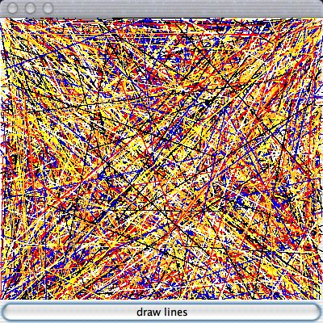
An Example

Slide 84
An Example (cont.)
public class Test extends JFrame{
private static final Color colors[] = { Color.red, Color.blue,
Color.yellow, Color.orange,
Color.black, Color.white };
public Test() {
// …
button.addActionListener(new ActionListener() {
public void actionPerformed(ActionEvent event) {
Graphics g = panel.getGraphics();
for(int i=0; i < NUMBER_OF_LINES; ++i) {
g.setColor(getRandomColor());
g.drawLine(getRandomX(), getRandomY(),
getRandomX(), getRandomY());
}
}
});
}
private Color getRandomColor() {
return colors[(int)(Math.random()*colors.length)];
}
// helper methods
}

Slide 85
An Example with Classes
public class Test extends JFrame{
public Test() {
//...
button.addActionListener(new ActionListener() {
public void actionPerformed(ActionEvent event) {
Graphics g = panel.getGraphics();
for(int i=0; i < NUMBER_OF_LINES; ++i) {
Color color = getRandomColor();
Line line = new Line(color,
getRandomX(), getRandomY(),
getRandomX(), getRandomY());
line.draw(g);
}
}
});
}
...
}
public class Line {
private Color color = Color.black;
private int x, y, x2, y2;
public Line(Color color, int x, int y, int x2, int y2) {
this.color = color; this.x = x; this.y = y; this.x2 = x2; this.y2 = y2;
}
public void draw(Graphics g) {
g.setColor(color);
g.drawLine(x, y, x2, y2);
}
}

Slide 86
Yikes!
We made 10,000 Line objects. That’s insane
Instead, let’s group lines by some fundamental characteristic, say color
Now we only need to create six lines; then we can reuse the implementation…

Slide 87
Flyweight Lines
public class Test extends JFrame {
//...
public Test() {
//...
button.addActionListener(new ActionListener() {
public void actionPerformed(ActionEvent event) {
Graphics g = panel.getGraphics();
for(int i=0; i < NUMBER_OF_LINES; ++i) {
Line line = LineFactory.getLine(getRandomColor());
line.draw(g, getRandomX(), getRandomY(),
getRandomX(), getRandomY());
}
}
});
}
//...
}

Slide 88
Flyweight Lines (cont.)
public class LineFactory {
private static final HashMap linesByColor = new HashMap();
public static Line getLine(Color color) {
Line line = (Line)linesByColor.get(color);
if(line == null) {
line = new Line(color);
linesByColor.put(color, line);
System.out.println("Creating " + color + " line");
}
return line;
}
}
public class Line {
private Color color;
public Line(Color color) {
this.color = color;
}
public void draw(Graphics g, int x, int y, int x2, int y2) {
g.setColor(color);
g.drawLine(x, y, x2, y2);
}
}

Slide 89
Questions?

Slide 90
Summarization
Creational patterns: dealing with object creations
Structural patterns: easing the design by identifying simple ways to realize relationships among entities.
Behavioral patterns: identifying communication patterns among entities

Slide 91
Principles
encapsulate what varies
favor composition over inheritence
program to interface, not to implementation
liskov substitute
open for extensions, closed for modification
depend upon abstractions, not upon implementations
least knowledge

Slide 92
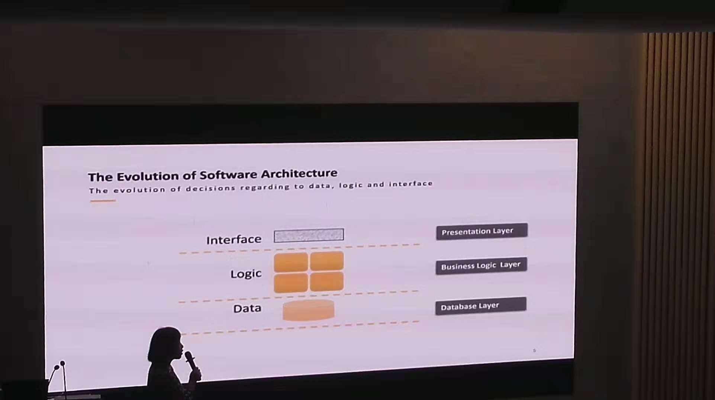
A little extras

Slide 93
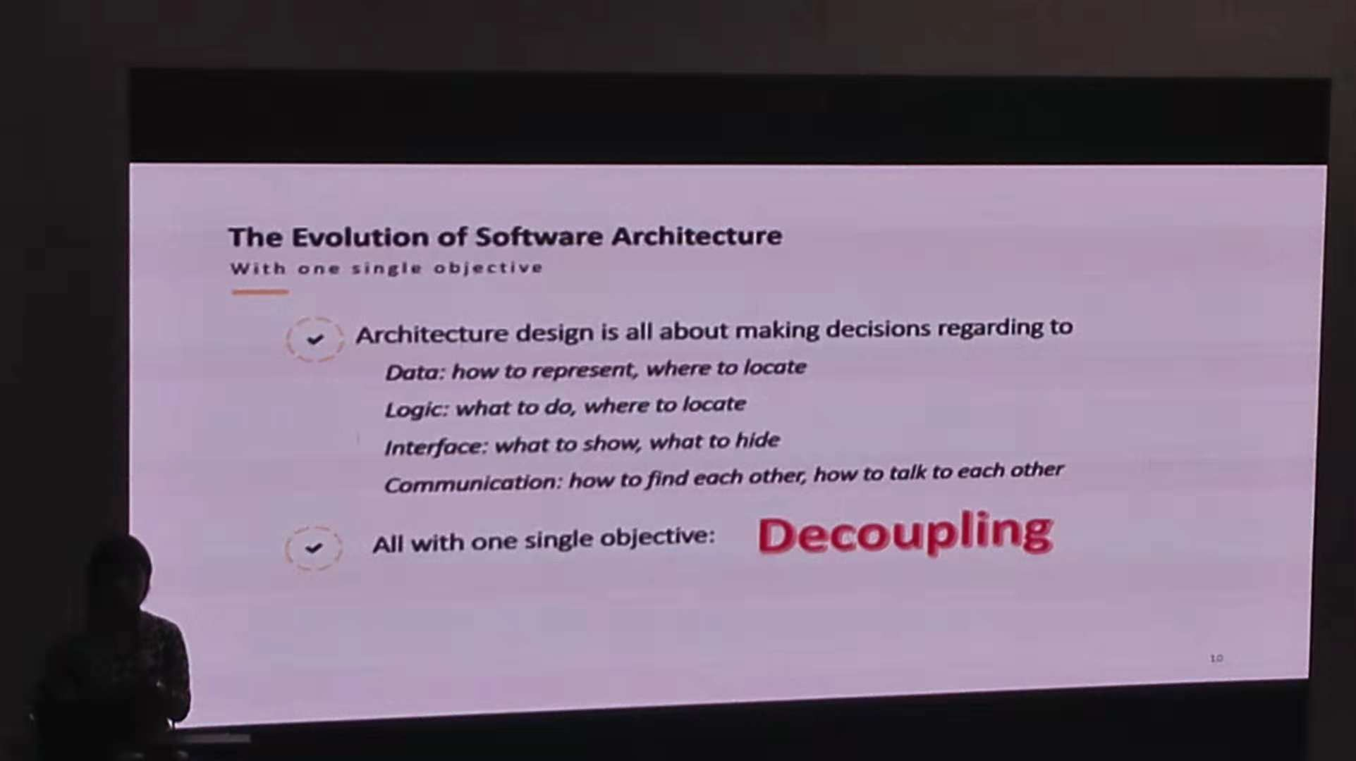
A little extras

